Slide 1
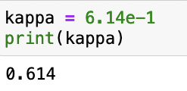
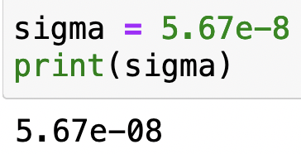
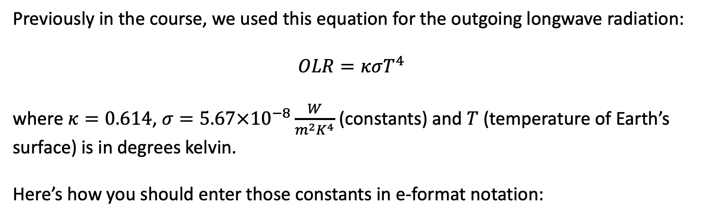
The e-format notation
Previously in the course, we used this equation for the outgoing longwave radiation:
$$OLR=κσT^{4}$$
where $κ=0.614$, $σ=5.67×{10}^{−8}\frac{W}{m^{2}K^{4}}$ (constants) and $T$ (temperature of Earth’s surface) is in degrees kelvin.
Here’s how you should enter those constants in e-format notation:

Slide 2
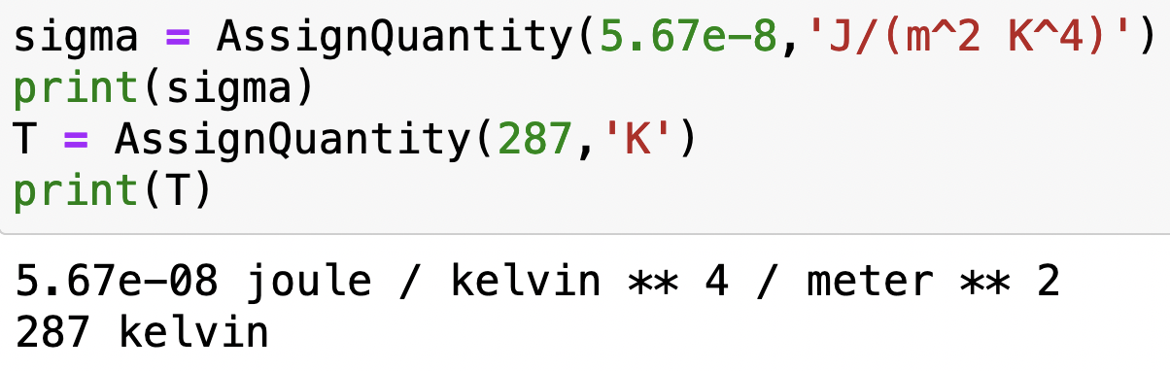
Units: using pint
Here’s how you bring pint into your Python notebook
Super-handy because AssignQuantity attaches units for you:

Slide 3
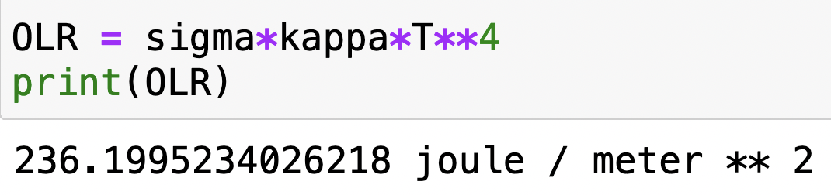
Units: using pint
pint also calculates units of the results of calculations:

Slide 4
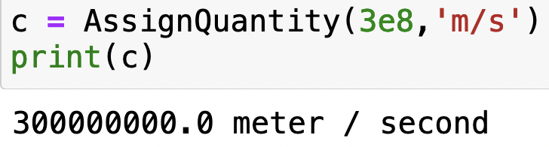
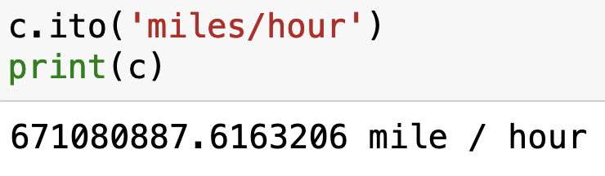
Units: using pint
pint can also do conversions for you, using “.ito”

Slide 5
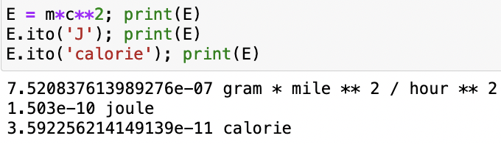
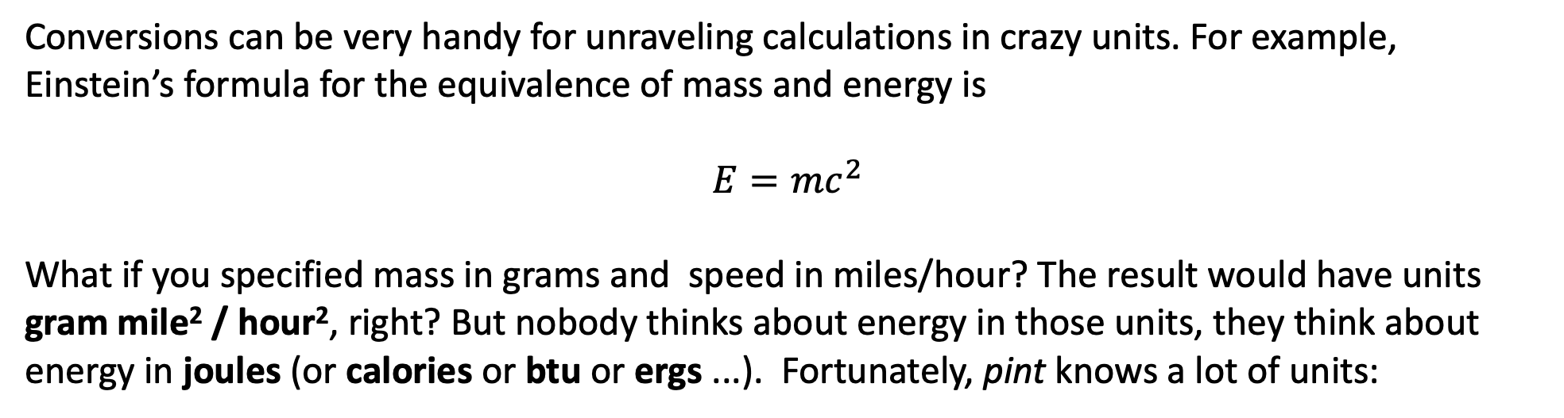
Units: using pint
Conversions can be very handy for unraveling calculations in crazy units. For example, Einstein’s formula for the equivalence of mass and energy is
$$E=mc^{2}$$
What if you specified mass in grams and speed in miles/hour? The result would have units gram mile² / hour², right? But nobody thinks about energy in those units, they think about energy in joules (or calories or btu or ergs ...). Fortunately, pint knows a lot of units:

